Slide 1
All About Taylor Swift
Ryan Li

Slide 2
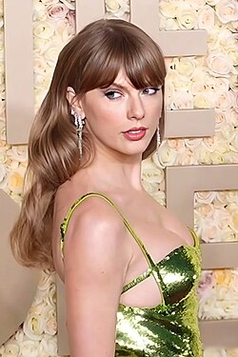
Hometown and Age
She is from Reading, pennsylvania
She is 35 years old.

Slide 3
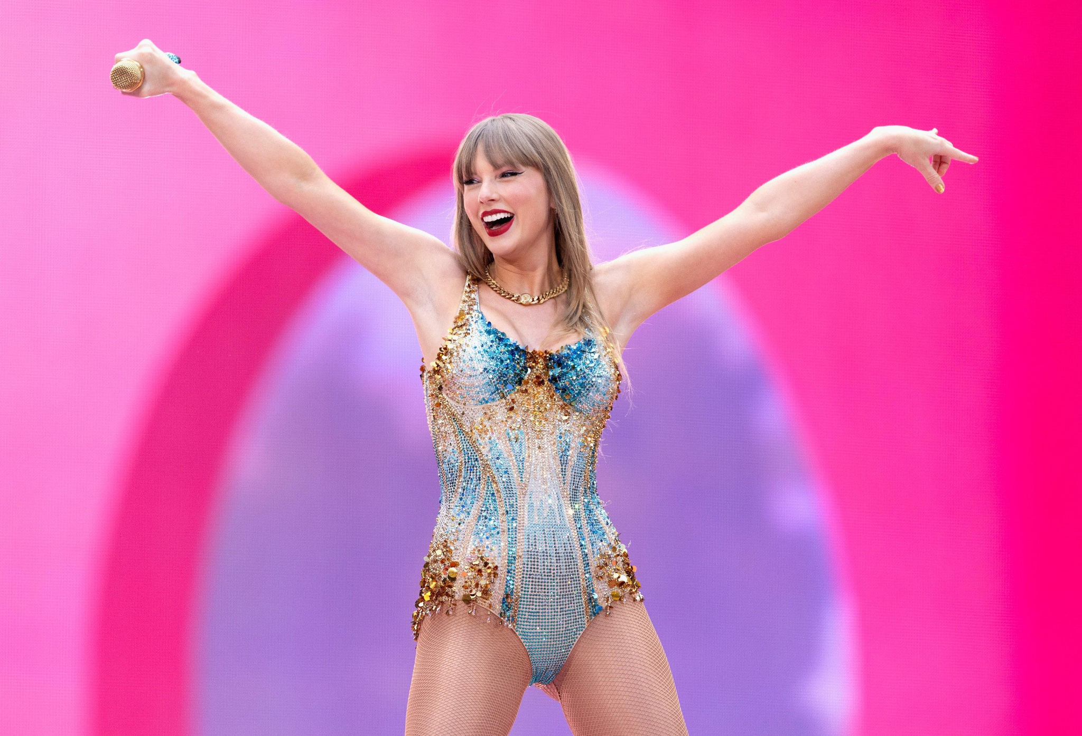
Profession
Singer and entertainer who writes poems

Slide 4
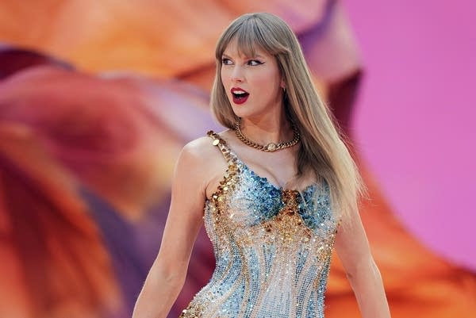
ACHIEVEMENTS
-winning the grammy award for four times
-leading the highest-grossing concert tour
-Most played artist on spotify

Slide 5
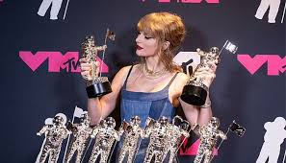
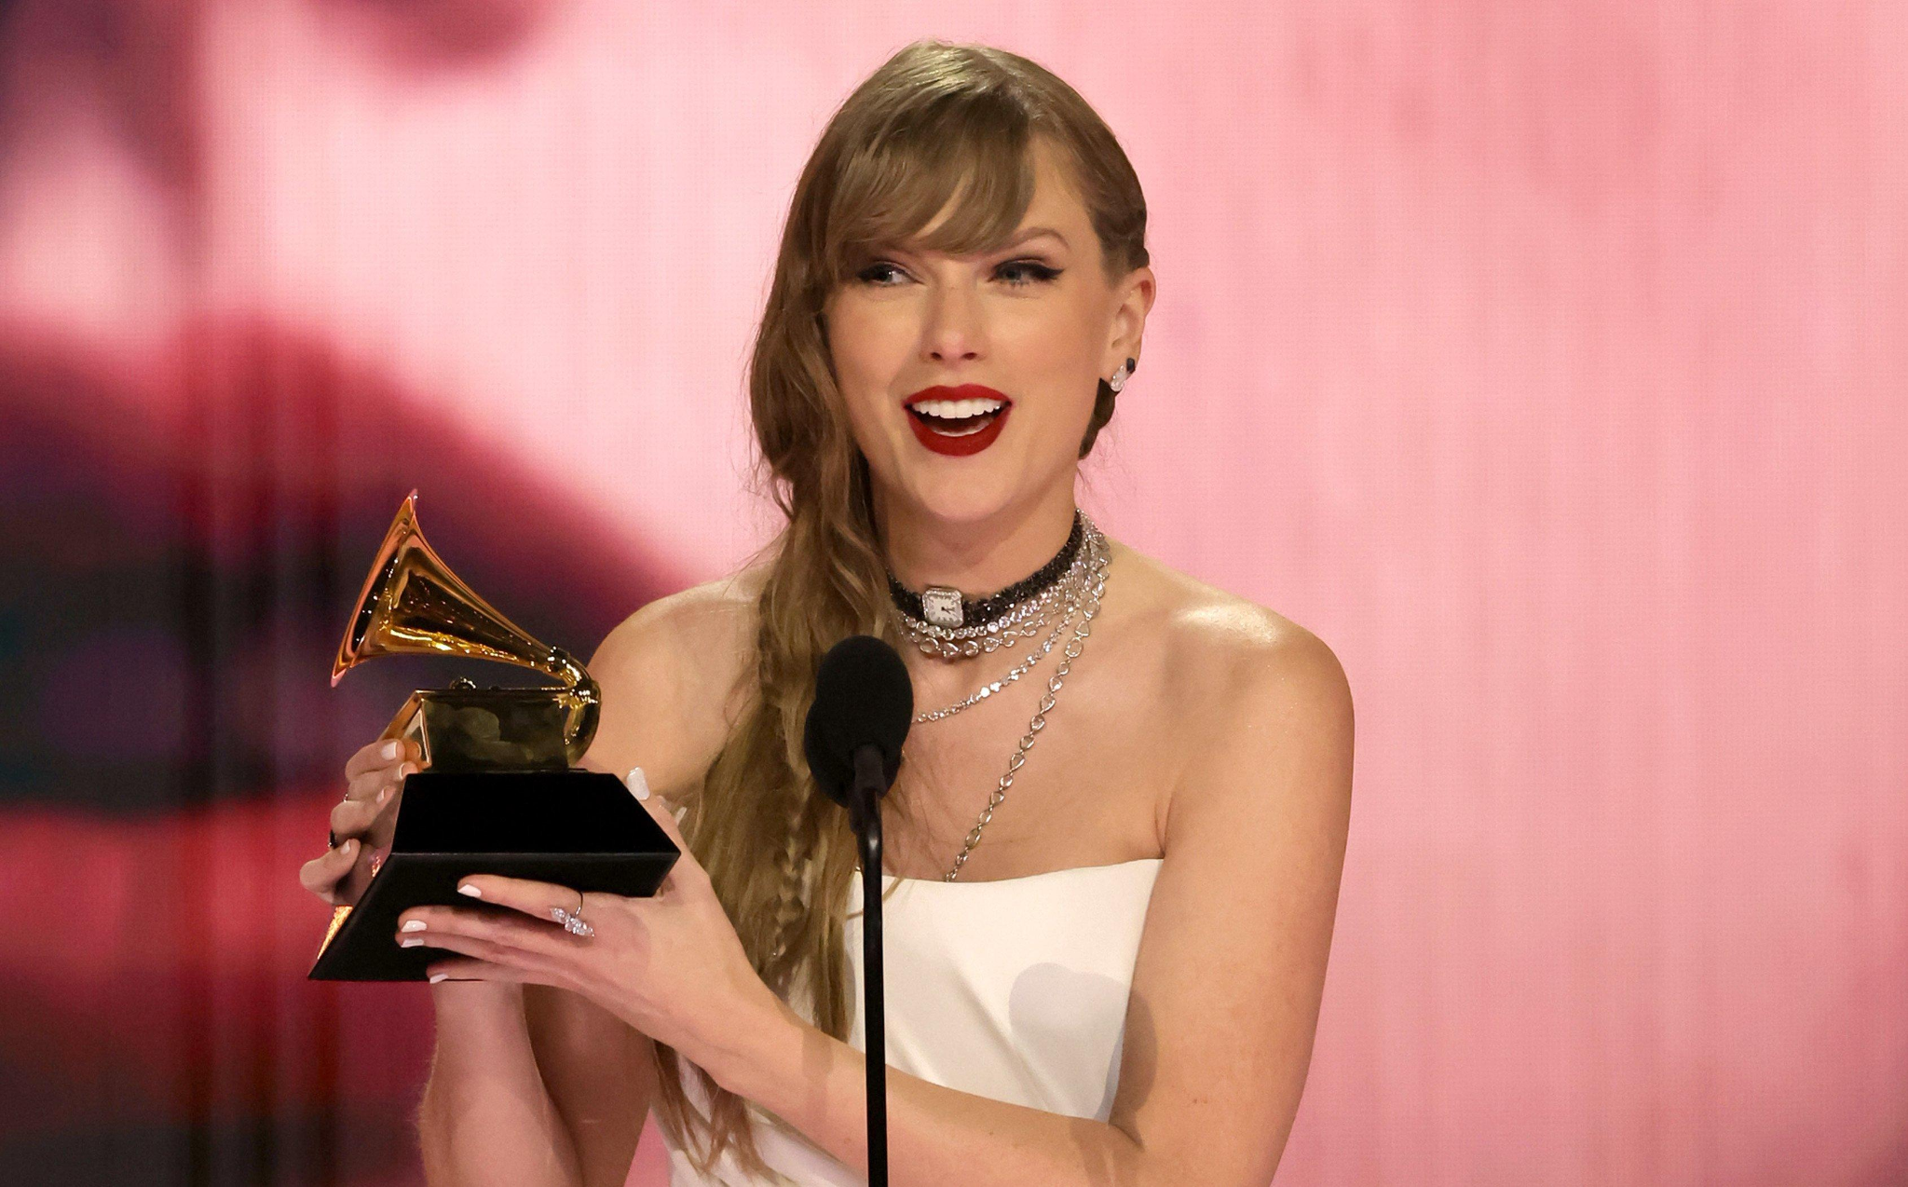
Entrepreneur type
- entertainer

Slide 6
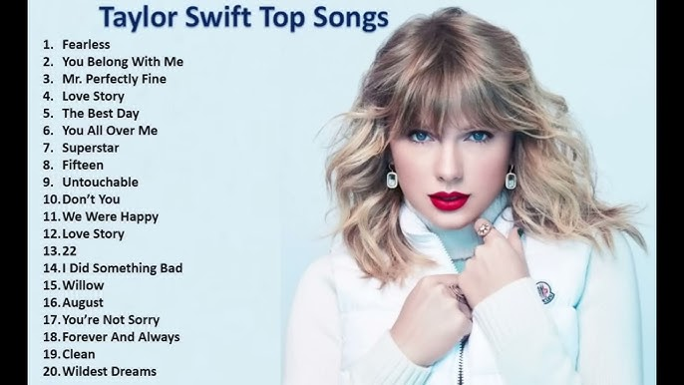
Inspiration
I chose her because i play piano and humm to myself softly

